Slide 1
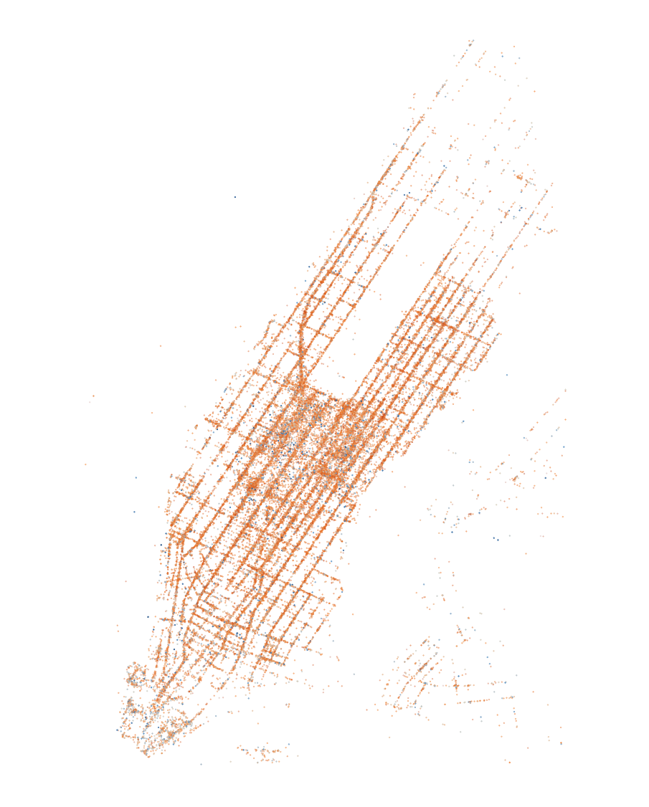
Predictive Power
Kriging and Machine Learning

Slide 2
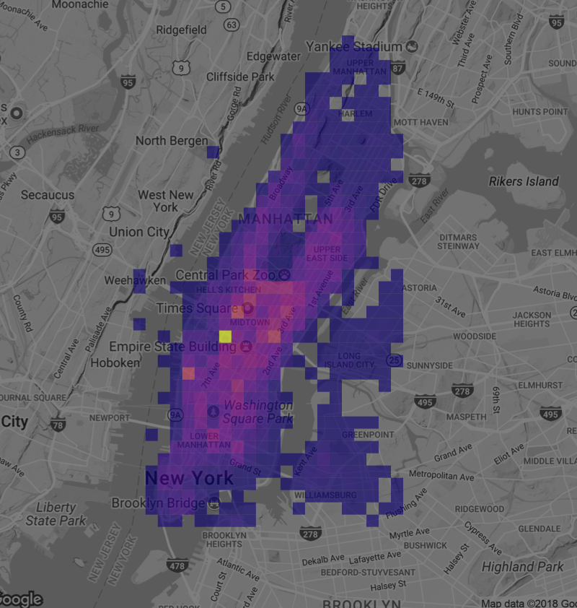
Project goals
How does predictive power of kriging compare with machine learning?
Three models to compare:
OLS
GAM with kriging of residuals
Random Forest
If cab drivers pick up passengers across Manhattan, does location matter for final amounts earned?

Slide 3
Data
The data set used for this project comes from the “FOILing NYC’s Taxi Trip Data” project (Whong, 2014).
Chris Whong published 20 gigabytes of NYC Taxi data.
Subset of 50,000 observations was randomly sampled, with each month of each year providing a roughly equal share of data points.

Slide 4
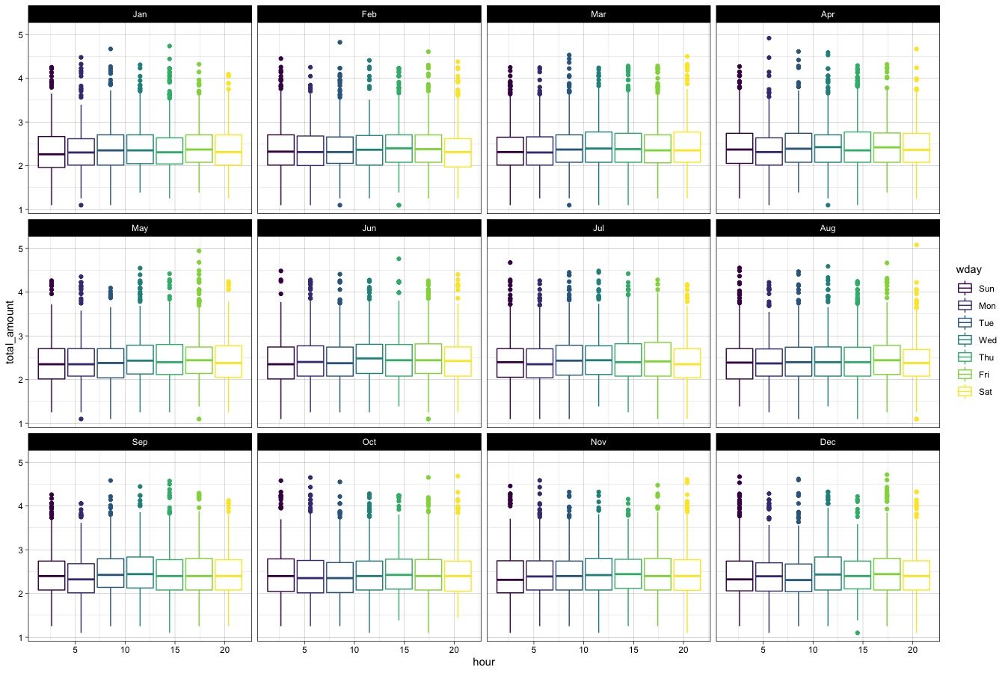

Slide 5
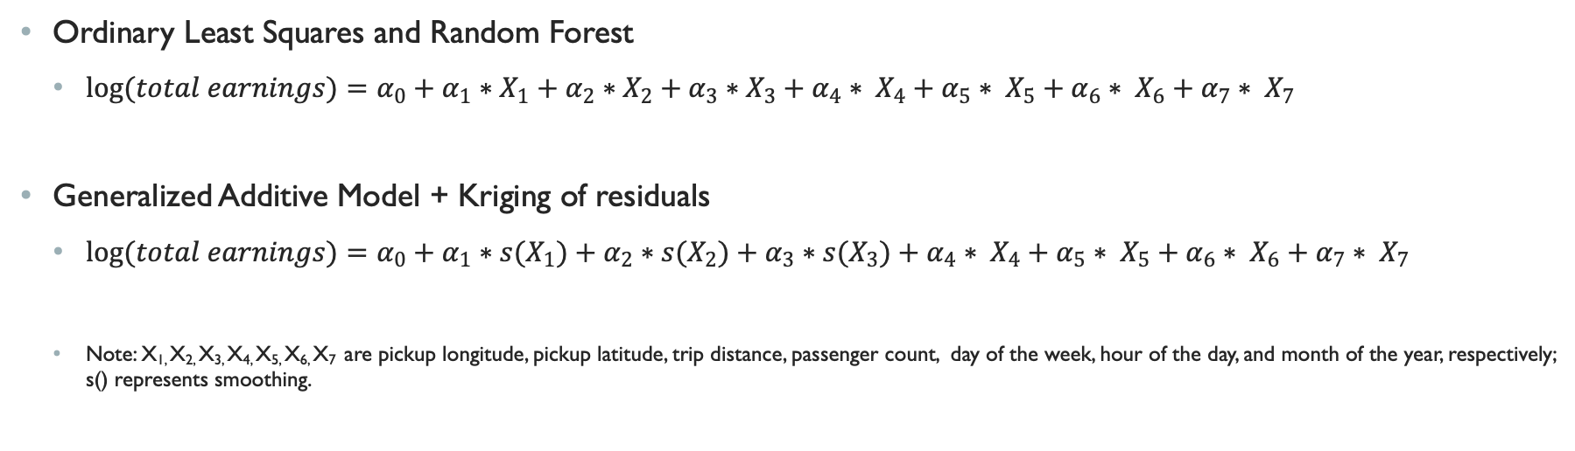
methods
Ordinary Least Squares and Random Forest
$log⁡(total earnings)=α_{0}+α_{1}∗X_{1}+α_{2}∗X_{2}+α_{3}∗X_{3}+α_{4}∗ X_{4}+α_{5}∗ X_{5}+α_{6}∗ X_{6}+α_{7}∗ X_{7}$
Generalized Additive Model + Kriging of residuals
$log(total earnings)=α_{0}+α_{1}∗{s(X}_{1})+α_{2}∗s(X_{2})+α_{3}∗s(X_{3})+α_{4}∗ X_{4}+α_{5}∗ X_{5}+α_{6}∗ X_{6}+α_{7}∗ X_{7}$
Note: X_{1,} X_{2,} X_{3,} X_{4,} X_{5,} X_{6,} X₇ are pickup longitude, pickup latitude, trip distance, passenger count, day of the week, hour of the day, and month of the year, respectively; s() represents smoothing.

Slide 6
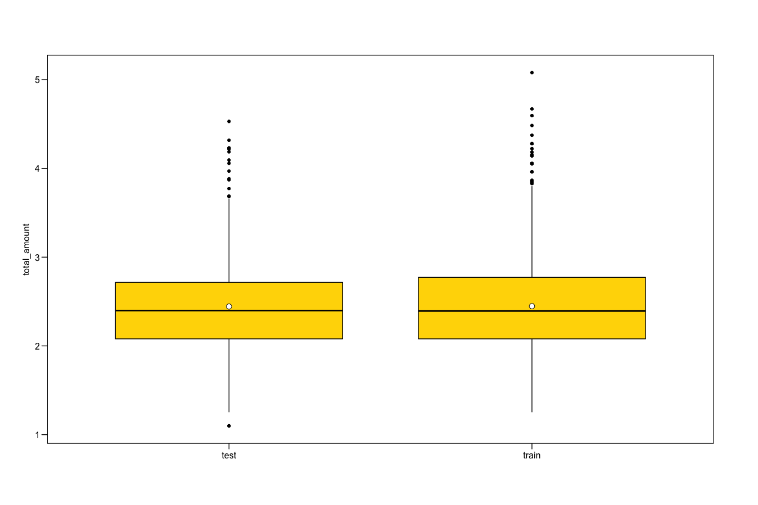
Splitting the data

Slide 7
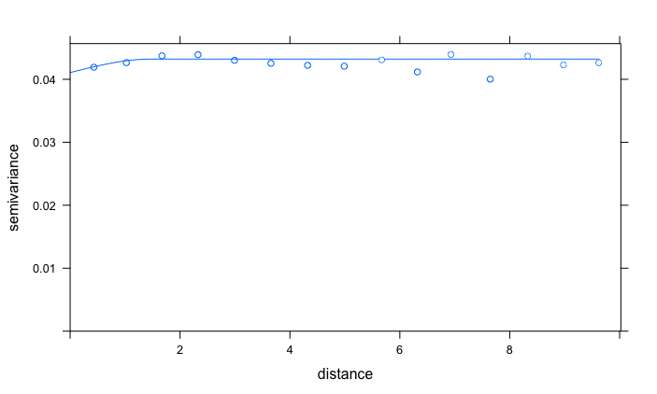
Variogram
Spherical fit
Mostly nugget effect
Possibly due to lack of horizontal variation in data
The fitting model was all the independent variables from the GAM and the residuals
Residuals ~ 1
Then the kriging predictions are added to the GAM ones

Slide 8
Results

Slide 9
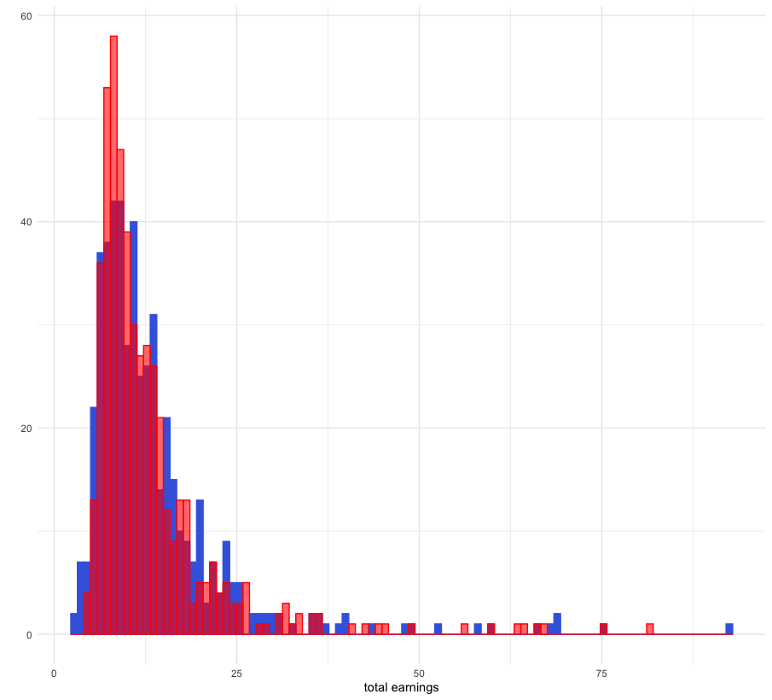
Data and GAM distributions

Slide 10
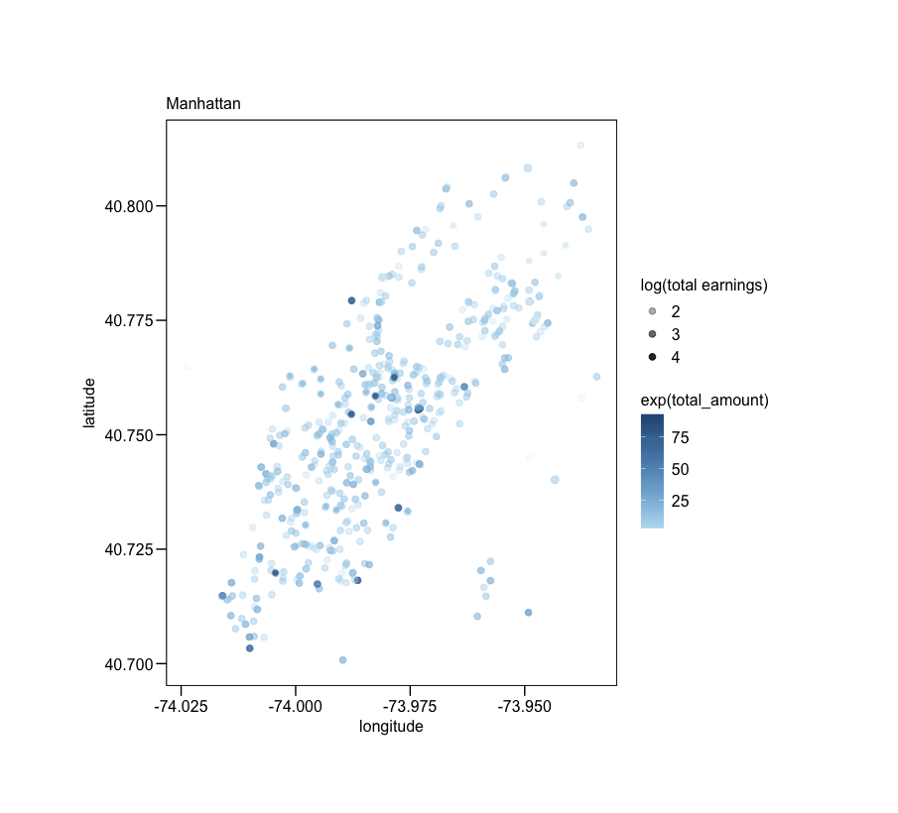
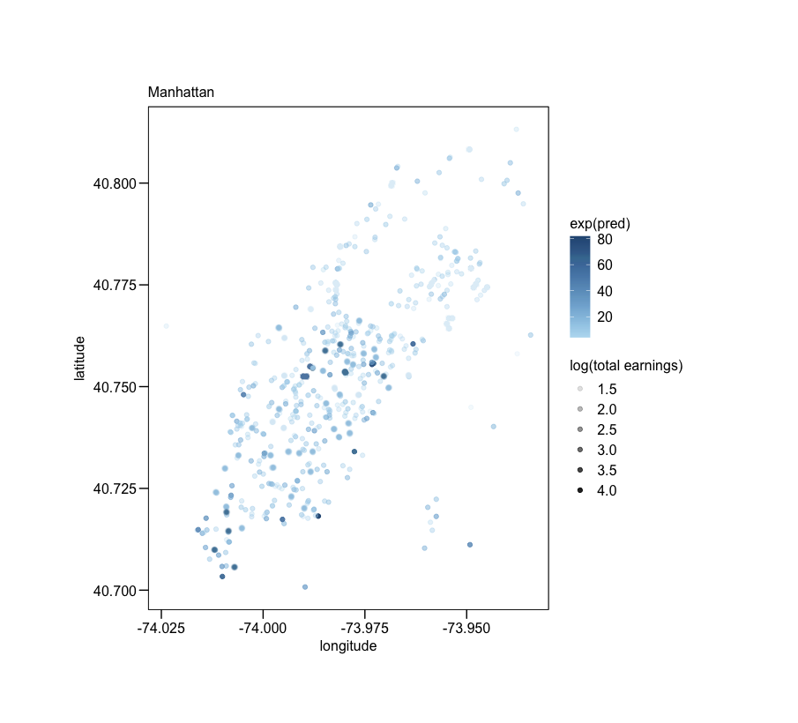
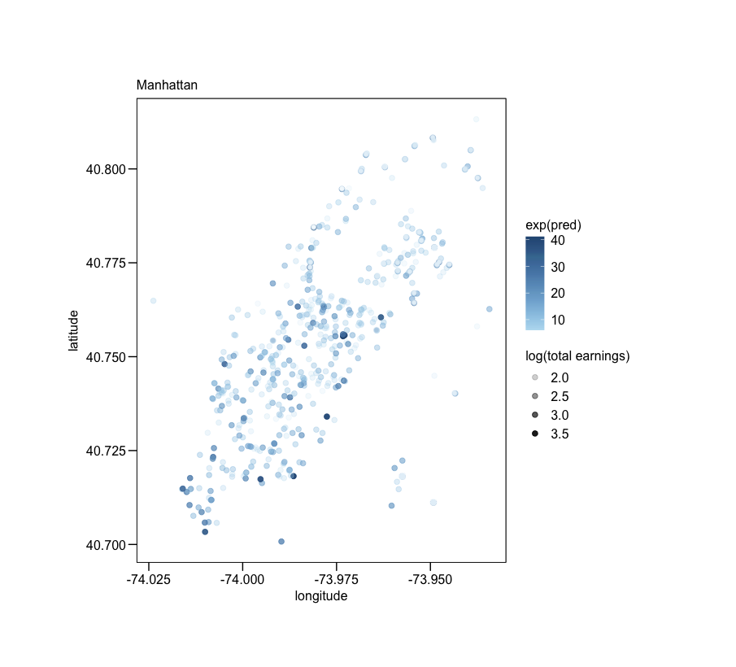
PREDICTION plots
Data
GAM + KRIGE
RANDOM forest

Slide 11
The end

